Slide 1




Future topics predictor based on users tweets
Ministère de l’Enseignement supérieur et de la Recherche scientifique Université de la Manouba Ecole Nationale des Sciences de l’Informatique
Realized by :
Rahma Akaichi
Abir Bel Haj Youssef
Academic Year : 2019/2020

Slide 2


CONCEPT & Problem Setting
01
03
ACHIEVED
02
PIPELINE
04
TO DO
OVERVIEW

Slide 3

Problem Setting and Concept
01

Slide 4


PROBLEM SETTING
At each minute about 350K tweets are generated
From users experessing their thougts and preferences about different products ,
2

Slide 5


CONCEPT
This projects aims at generating a convLSTM model able to predict User’s future preferences based on their tweets,

Slide 6
PROJECT’S PIPELINE
02

Slide 7



Pipeline
Data Preprocessing
Model Buidling
Data Gathering
Word Embedding
Evaluation and prediction

Slide 8
Yet Achieved
03

Slide 9
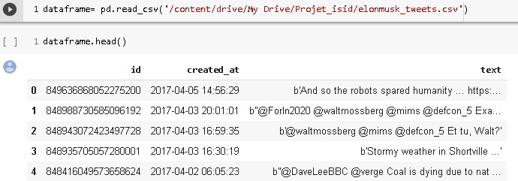
-Irrevelant Data(id)
-unstructured Data(created_at)
-lots of noise(punctuations , hyperlinks)
Initial Data:

Slide 10
Text pre-processing
Tokenization & Normalisation
I- Feature Selection
Keep the most releveant feature for the predicition(in our case Date & tweet)
Get stems from generated tokens and corresponding tag
II- Text Cleaning
Keyword Extraction & Sequence Generation
Removing stopwords , hyperlinks , punctuations , non english words,,
Get most relevant keywords Using TF-IDF and turn them into Sequences

Slide 11
Date Pre-processing

Slide 12
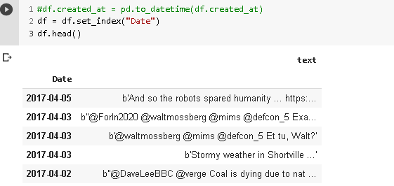
Date Preprocessing

Slide 13
Text Pre-processing

Slide 14
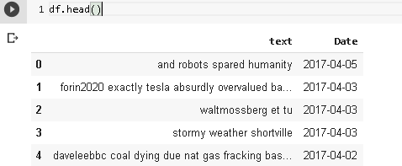
Text Preprocessing

Slide 15
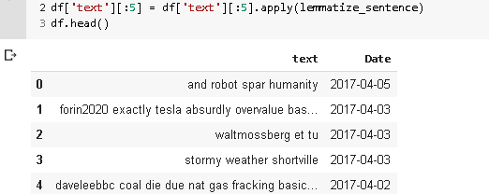
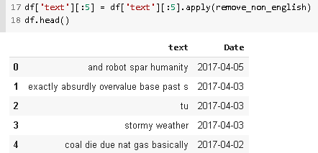
After Part of Speech Tagging and Lemmatization
After removing non English Words

Slide 16
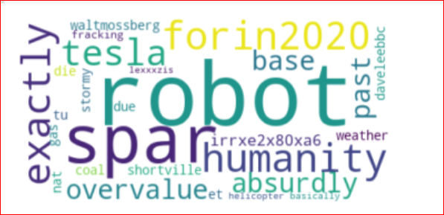
CORPUS WORDCLOUD VIZUALIZATION

Slide 17
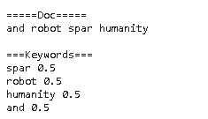
Keywords Extraction based on their probability of Occurrence
Keywords Extraction from Document 1

Slide 18
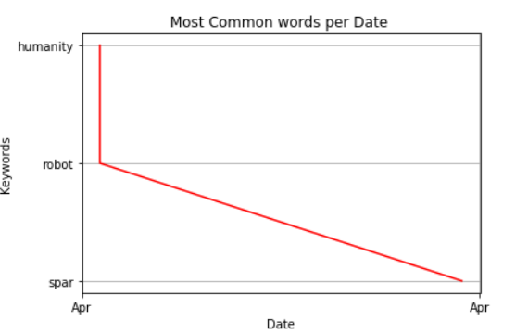
Most Common topics during April

Slide 19
Word Embedding

Slide 20
TO DO
04

Slide 21

WHAT IS LEFT?
Feature Selection
Feature Engineering
Word Embedding
Model Building & Evaluation
Prediction

Slide 22

Thanks for you attention!

